Slide 1
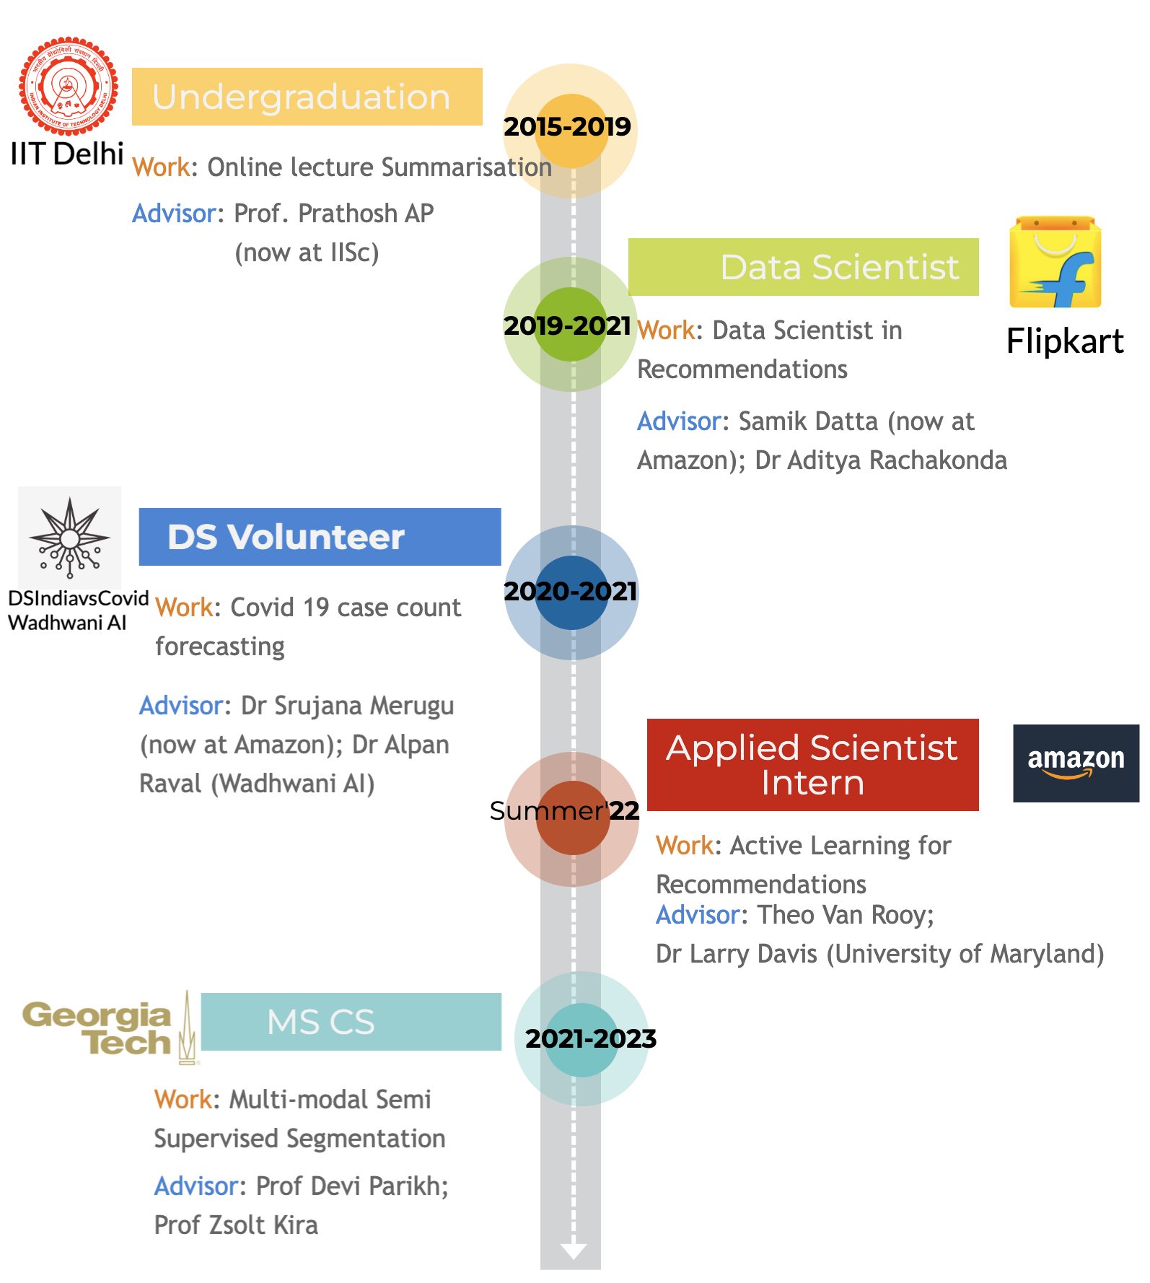


Introduction
Harsh Maheshwari
https://harshm121.github.io/

Slide 2
Recommendation of Compatible Outfits Conditioned on Style

Slide 3



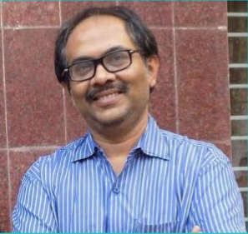

Recommendation of Compatible Outfits Conditioned on Style
Harsh Maheshwari*
Debopriyo Banerjee*
Lucky Dhakad*
Muthusamy Chelliah
Niloy Ganguly
Arnab Bhattacharya
Flipkart
IIT Kgp
Flipkart
Flipkart
IIT Kgp
Flipkart
Published at ECIR’22 (oral)

Slide 4
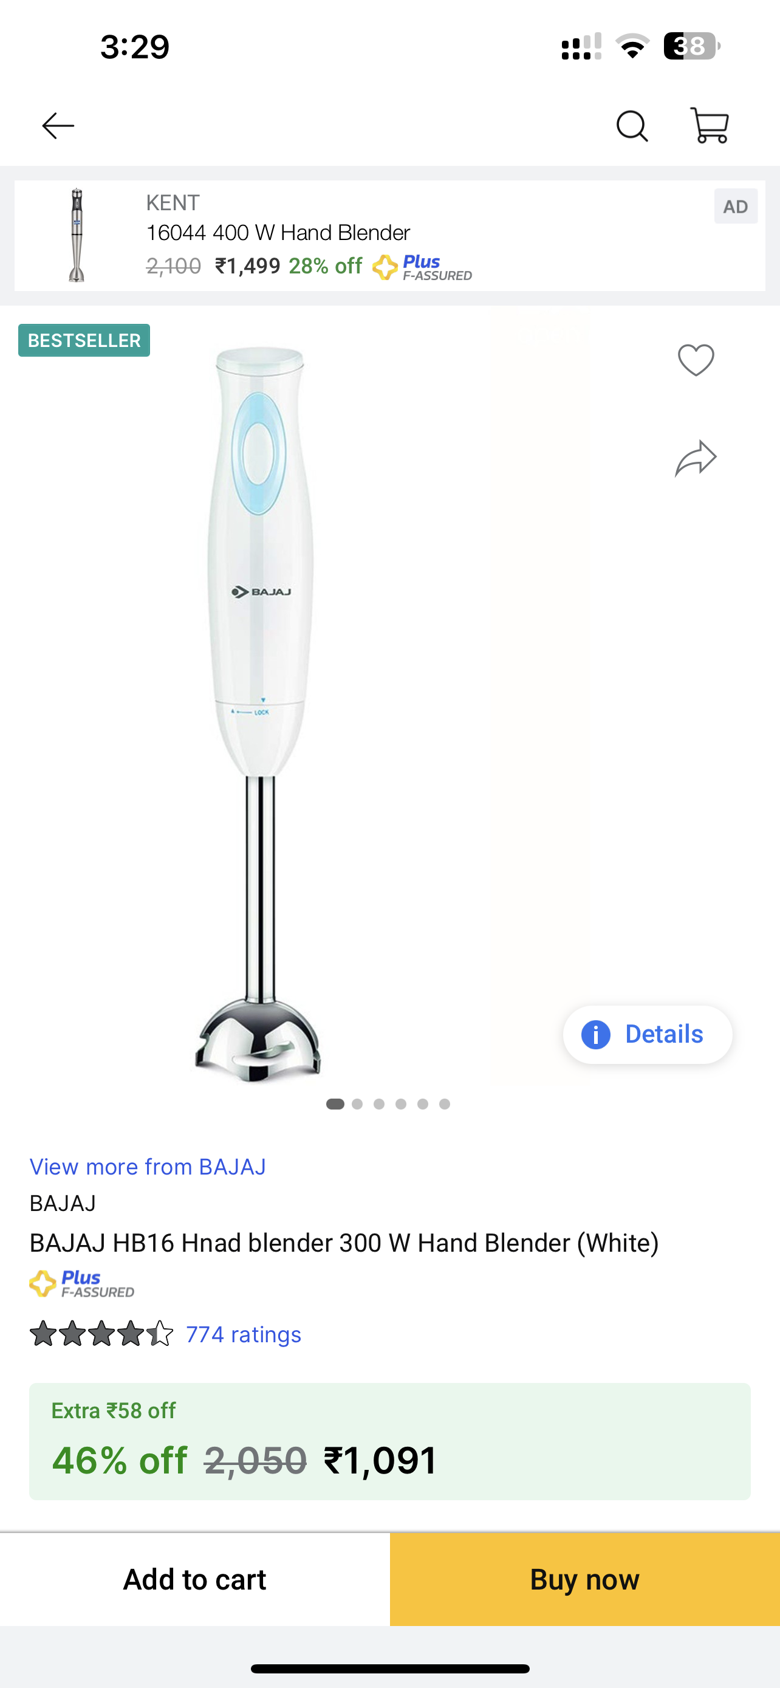
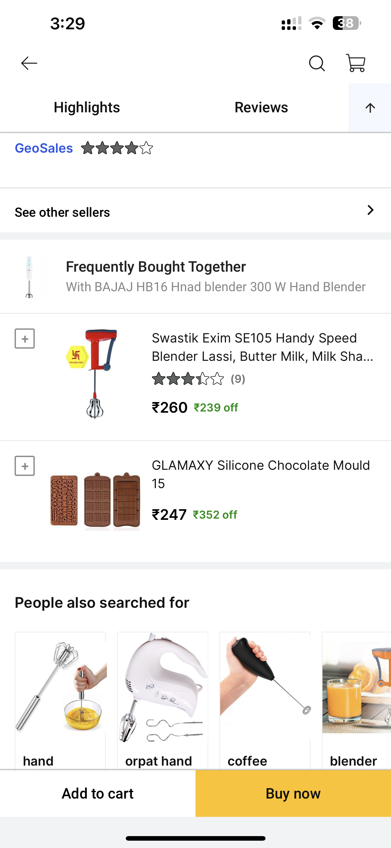
Business problem statement
Flipkart – 200M users; 150M products
Recommendations led to 30% sales

Slide 5
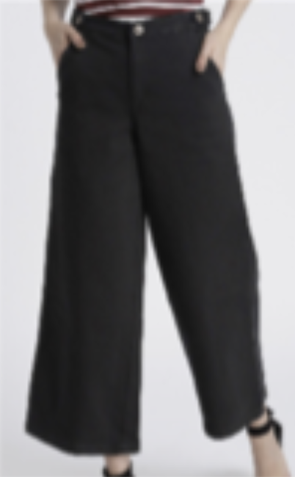
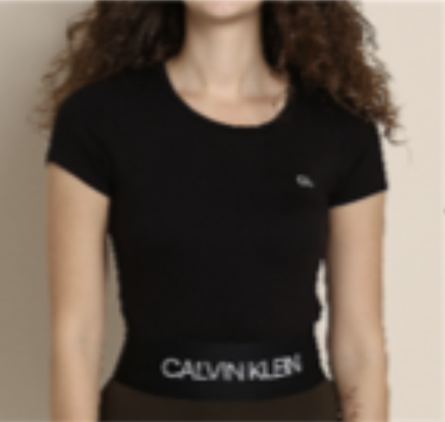
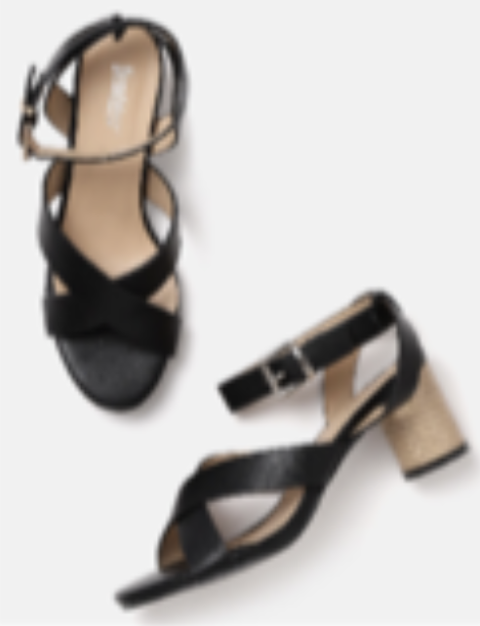
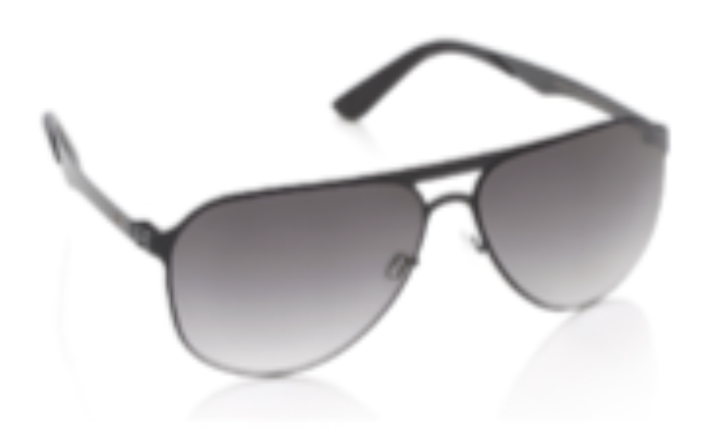
Problem statement
Bottom wear
Foot wear
Top wear
Accessory

Slide 6
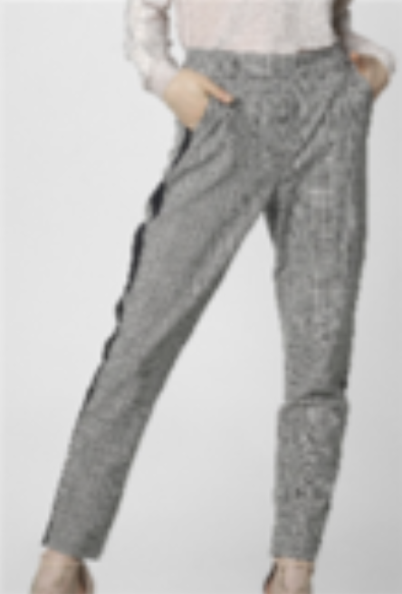
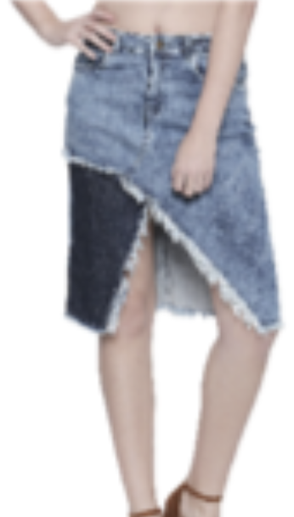
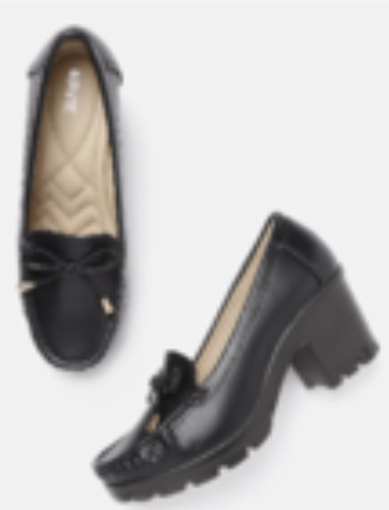
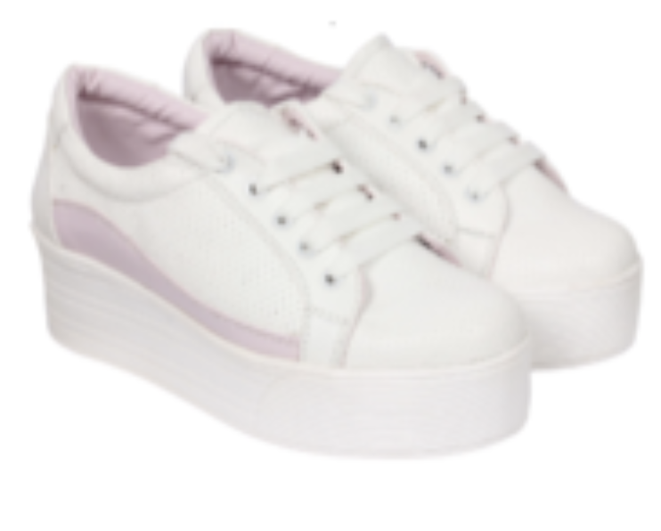
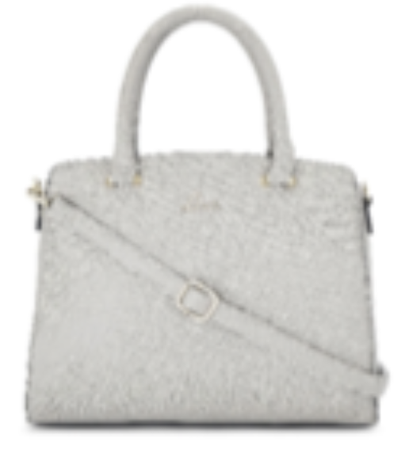
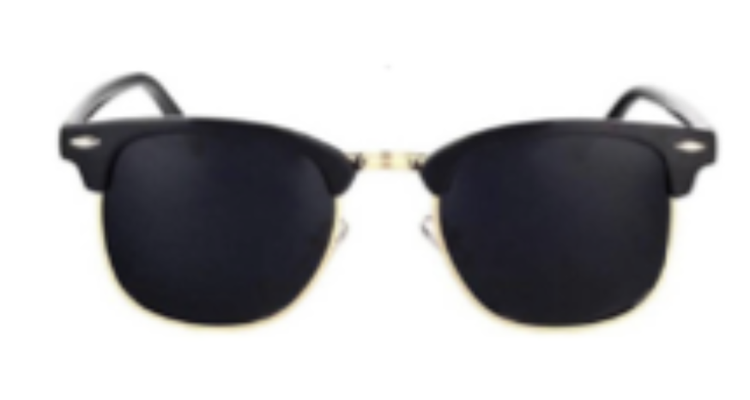
Problem statement
. . .
Bottom wears
. . .
Foot wears
Top wear
. . .
Accessories

Slide 7
Problem statement
. . .
Bottom wears
“Compatible”
. . .
Foot wears
Top wear
. . .
Accessories

Slide 8
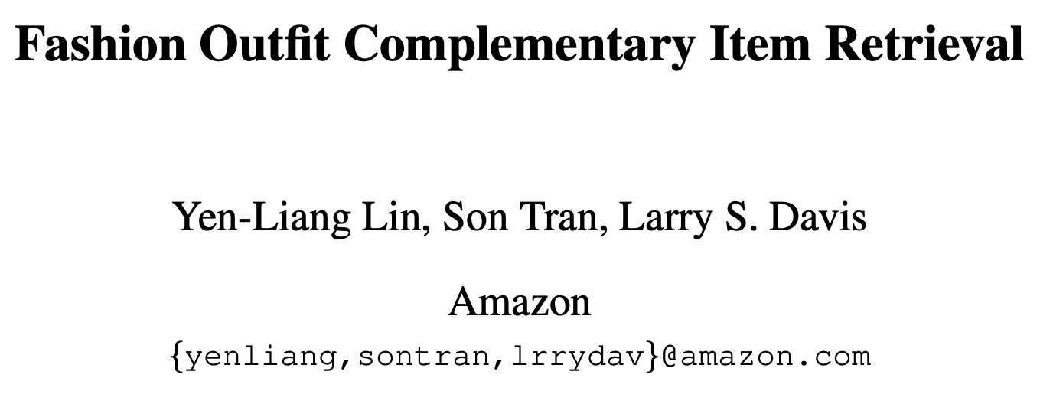
Existing Work
CVPR 2020

Slide 9
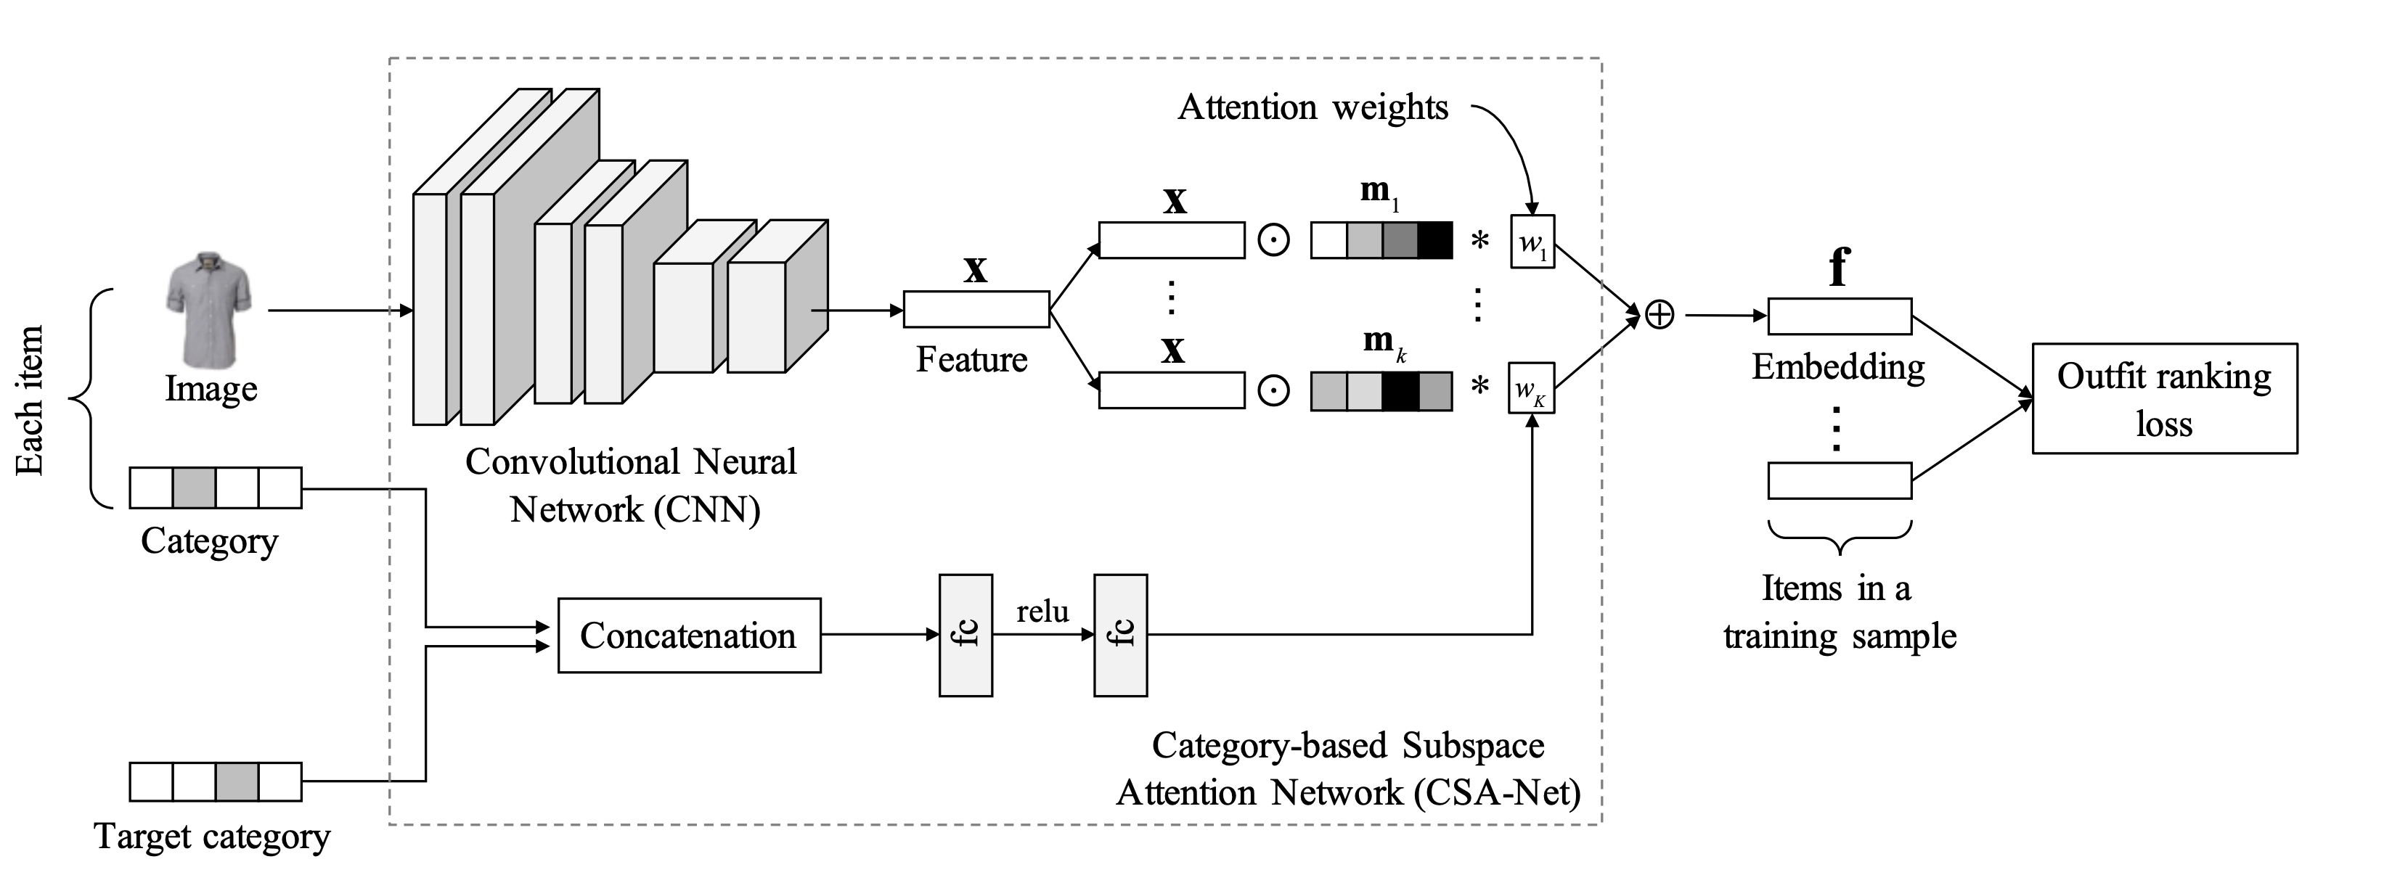

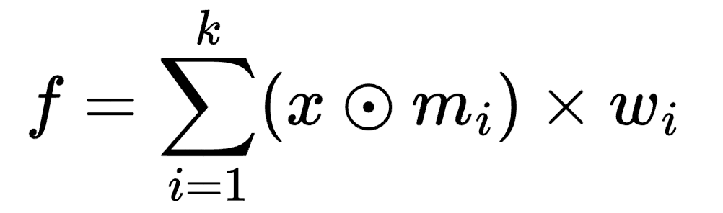

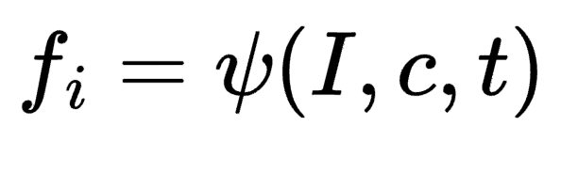
Existing Work

Slide 10
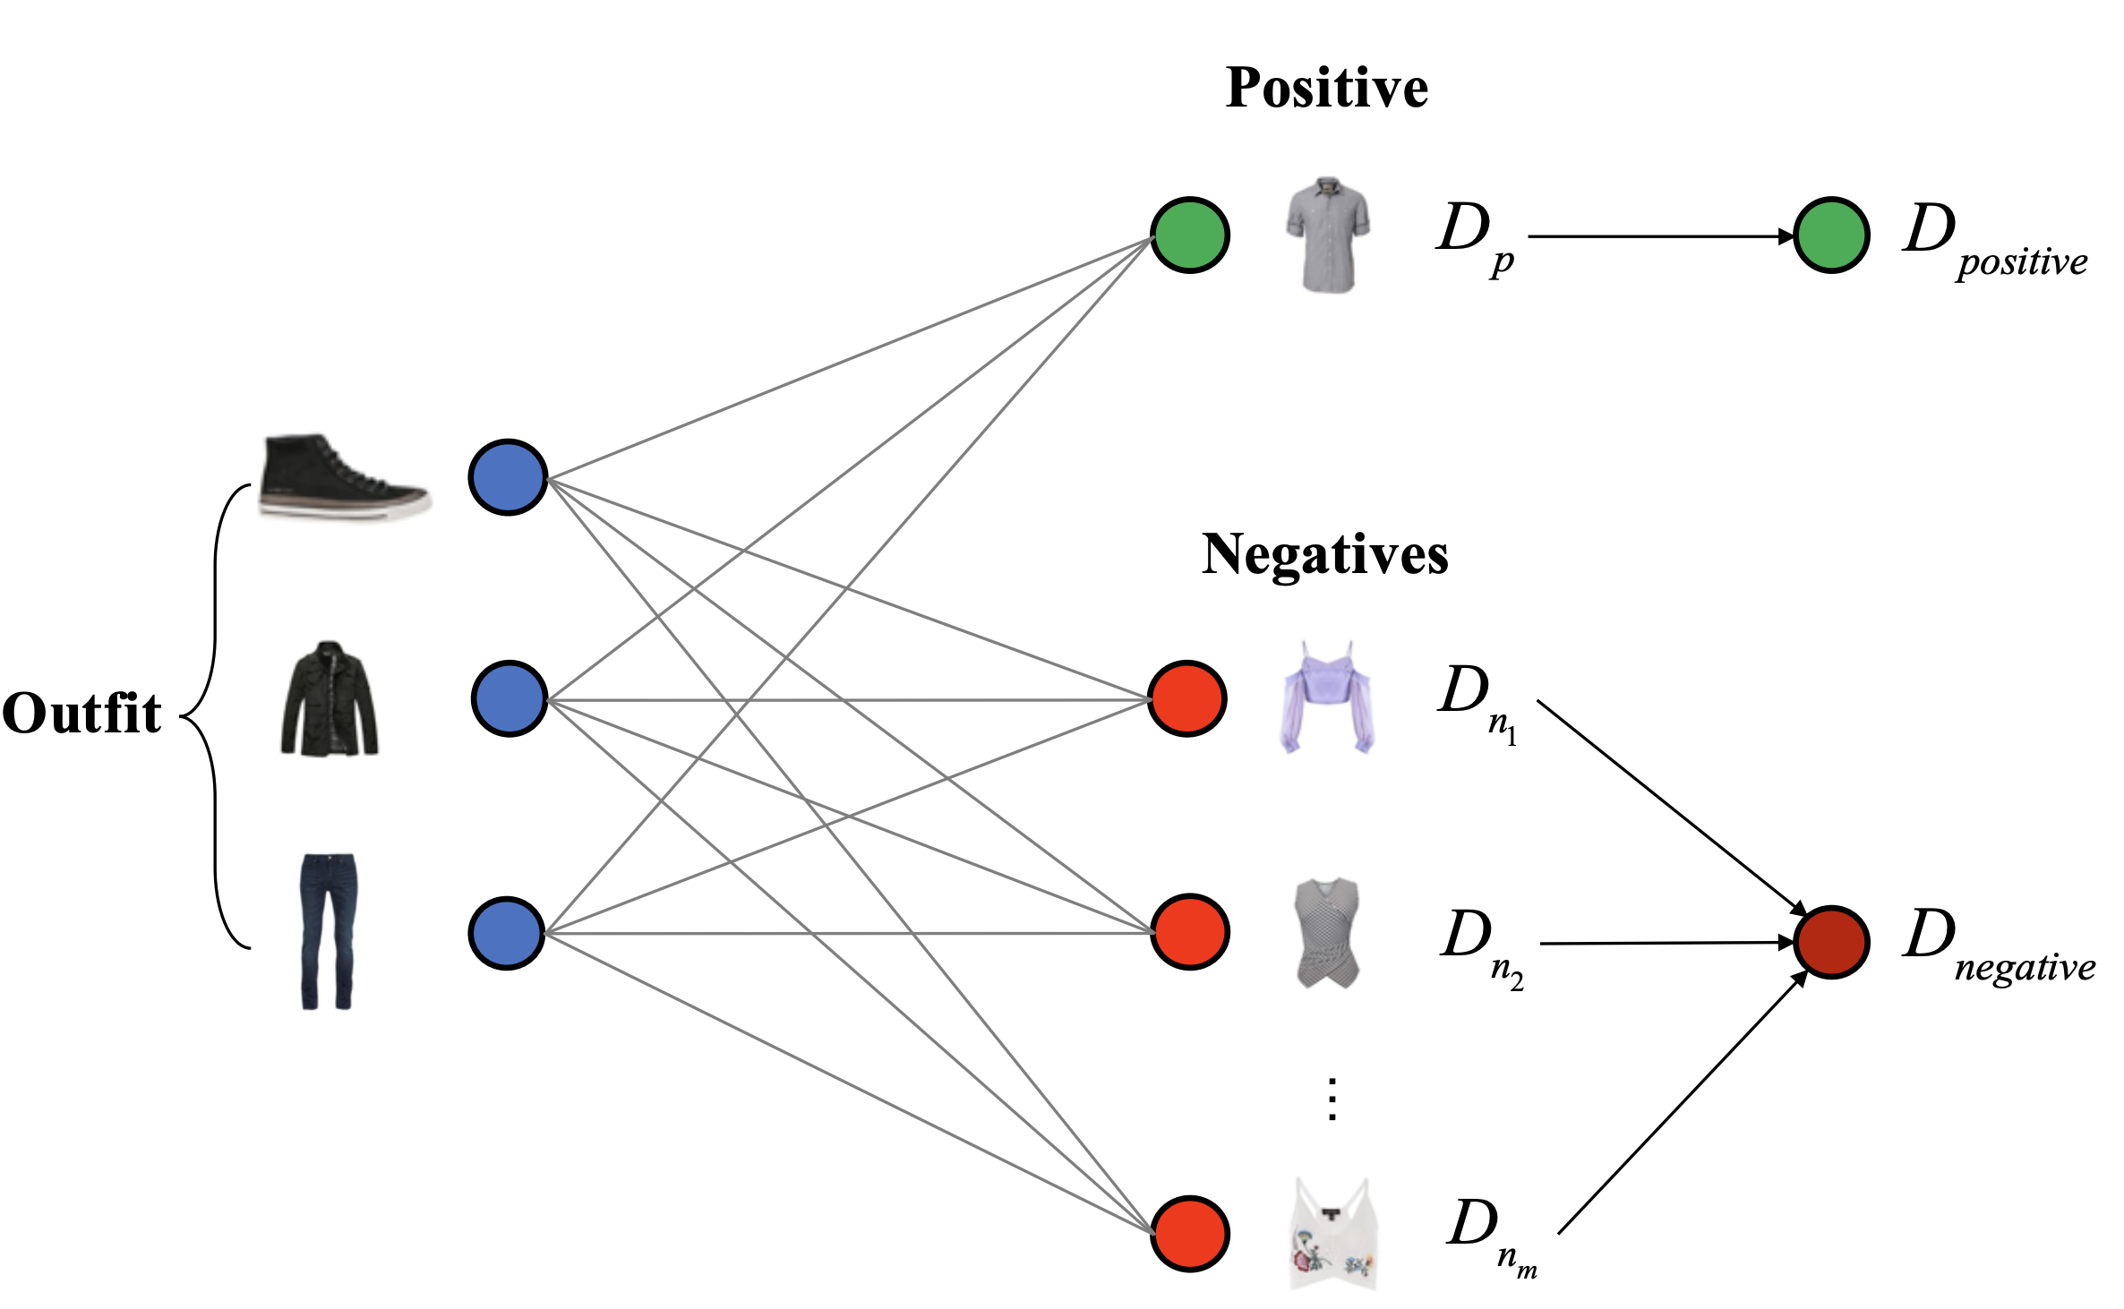


Existing Work

Slide 11
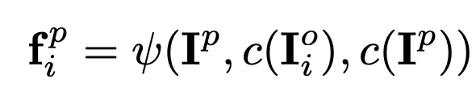
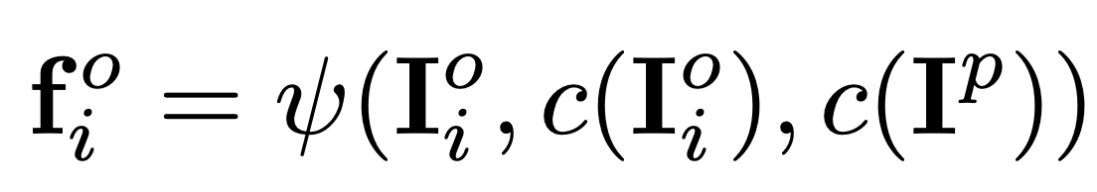
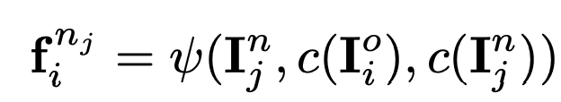
Existing Work

Slide 12
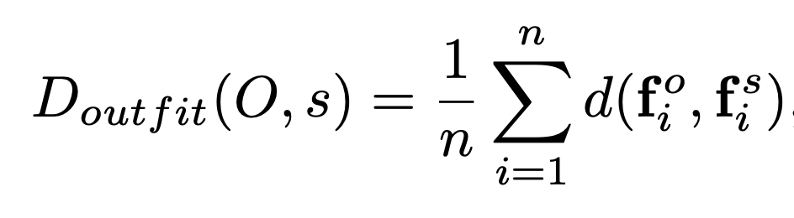
Existing Work

Slide 13
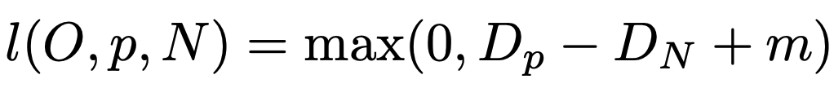
Existing Work

Slide 14
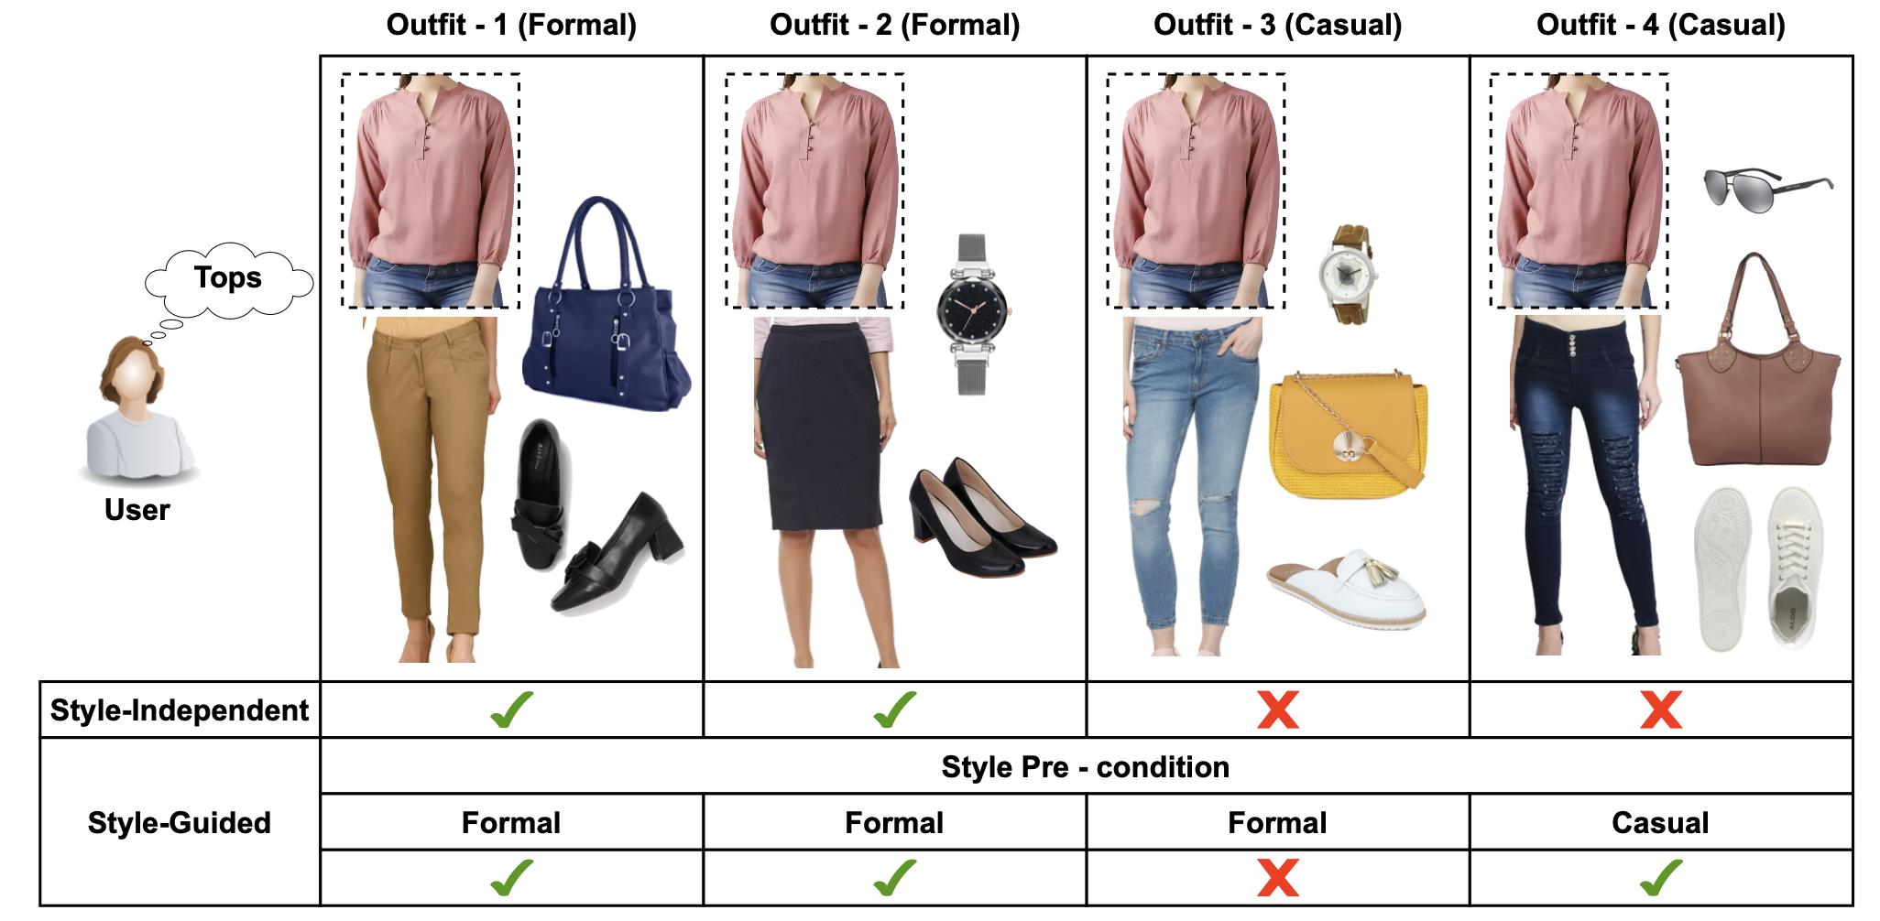
Gap – Style Conditioning

Slide 15
Gap – Style Conditioning

Slide 16
Gap – Style Conditioning
Compatibility is inherently conditioned on style

Slide 17
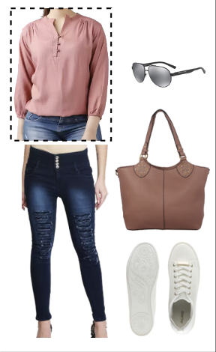
Objective
Anchor item
Template: <tops, skirts, shoes, accessory>
Style

Slide 18
Objective
Anchor item
Template: <tops, skirts, shoes, accessory>
Style

Slide 19
Objective
Anchor item
?
Template: <tops, skirts, shoes, accessory>
Style

Slide 20
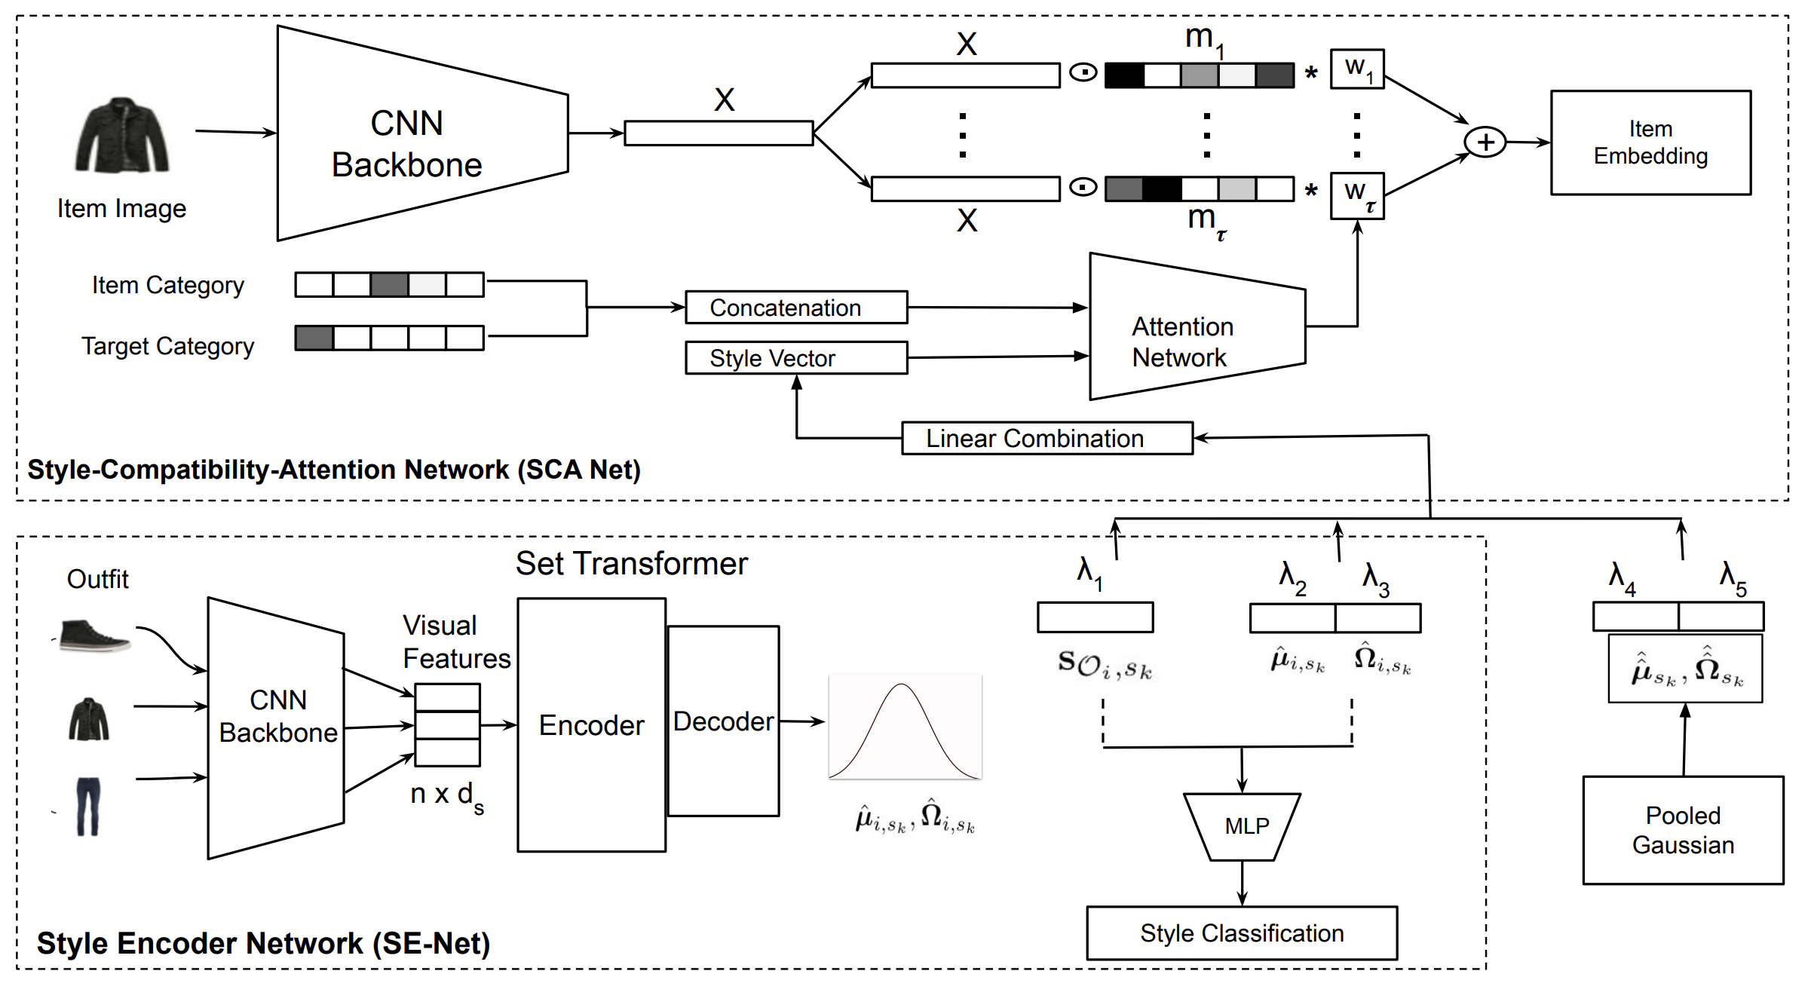

Our proposal
?
?
How to condition the representations on style?

Slide 21
Our proposal
?
How to condition the representations on style?

Slide 22
Our proposal
?
How to condition the representations on style?

Slide 23
Our proposal
?
How to condition the representations on style?

Slide 24
Our proposal
?
?
How to get this style vector?

Slide 25
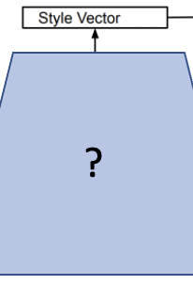
Our proposal
?
?

Slide 26
Our proposal
What do we expect from this style vector?
?
?

Slide 27

Our proposal
What do we expect from this style vector?
?
Should represent the ‘style’ of the outfit (set)
Should be able to handle set as an input
Should be suitable for outfit creation
Available during inference
Randomness can help in diversification + modelling fuzziness

Slide 28
Our proposal
What do we expect from this style vector?
?
Should represent the ‘style’ of the outfit (set)
Should be able to handle set as an input
Should be suitable for outfit creation
Available during inference
Randomness can help in diversification + modelling fuzziness
We need a learnt smooth tractable latent space!

Slide 29
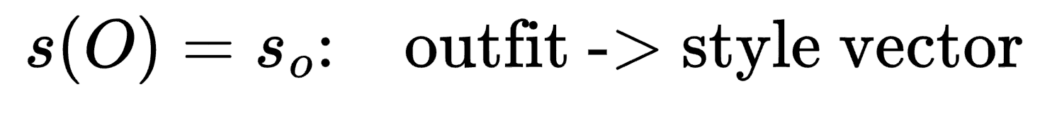
Our proposal
What do we expect from this style vector?
?
Should represent the ‘style’ of the outfit (set)
Should be able to handle set as an input
Should be suitable for outfit creation
Available during inference
Randomness can help in diversification + modelling fuzziness
We need a learnt smooth tractable latent space!

Slide 30
Our proposal
What do we expect from this style vector?
?
Should represent the ‘style’ of the outfit (set)
Should be able to handle set as an input
Should be suitable for outfit creation
Available during inference
Randomness can help in diversification + modelling fuzziness
We need a learnt smooth tractable latent space!
VAE!

Slide 31
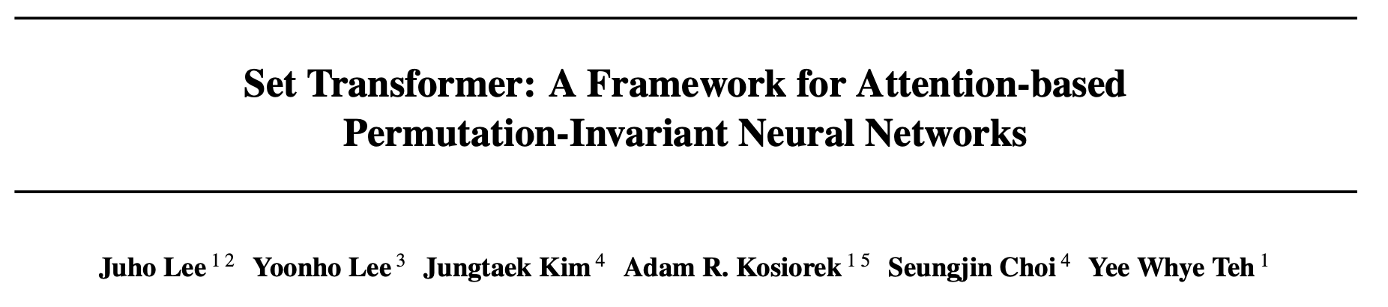
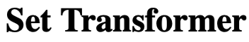
Handling sets as input - Set Transformer
ICML 2019

Slide 32

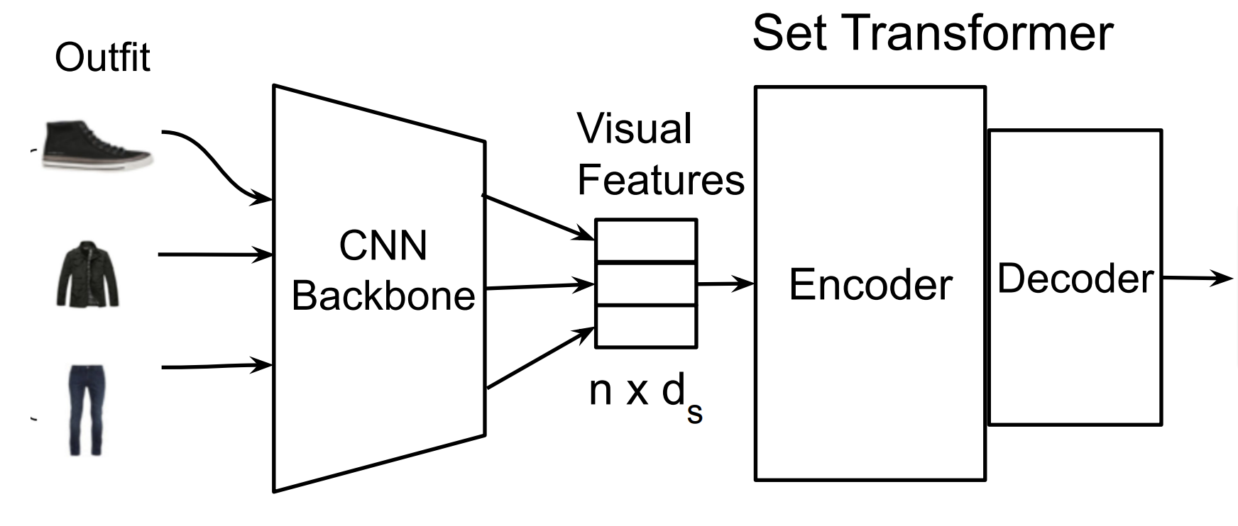
Handling sets as input - Set Transformer

Slide 33
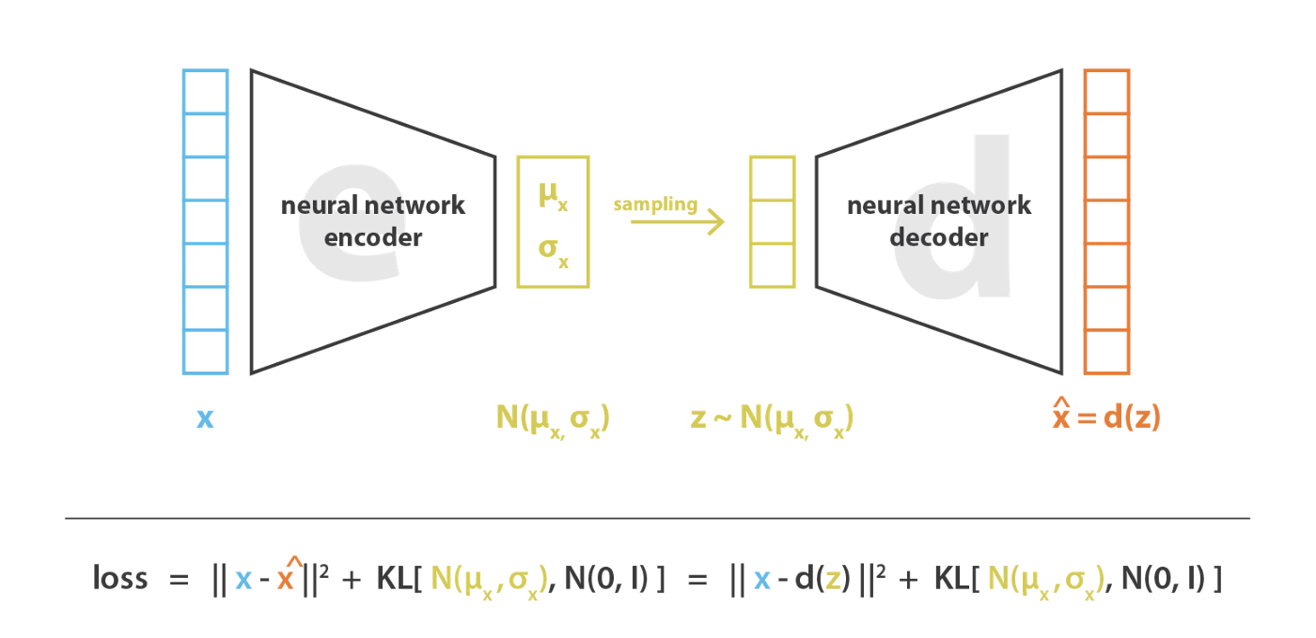
Smooth latent space – VAE!
Source: https://towardsdatascience.com/understanding-variational-autoencoders-vaes-f70510919f73

Slide 34


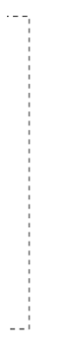
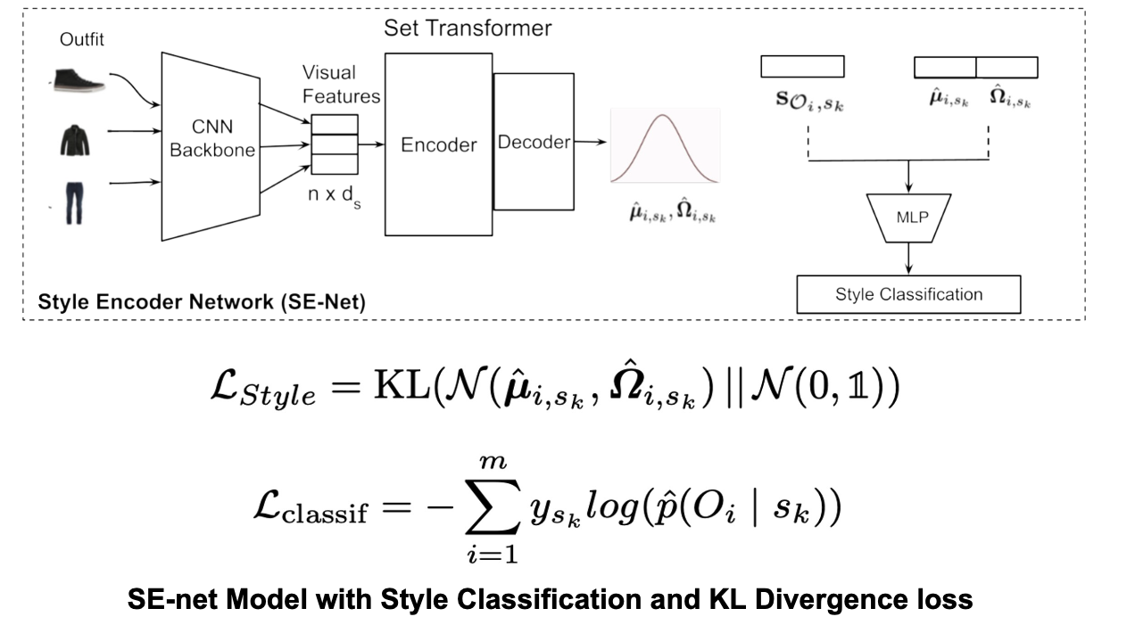
Smooth latent space – VAE!
Do we need to reconstruct the entire outfit?
We need our Style Encoder to capture just the style of the outfit.

Slide 35
Smooth latent space – VAE!

Slide 36

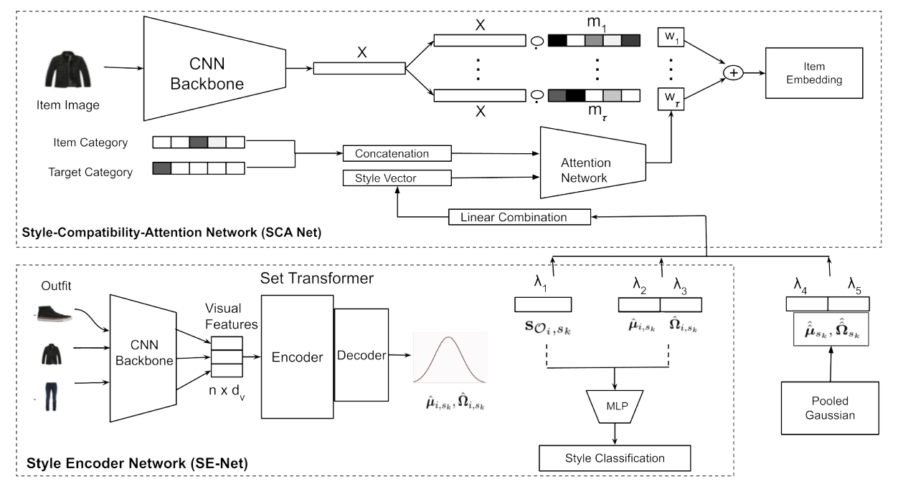
Smooth latent space – VAE!

Slide 37

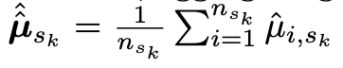
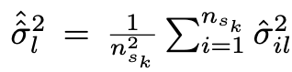
Our proposal

Slide 38
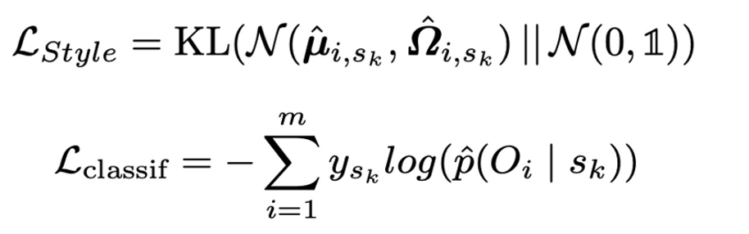
Losses

Slide 39


Losses

Slide 40
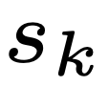
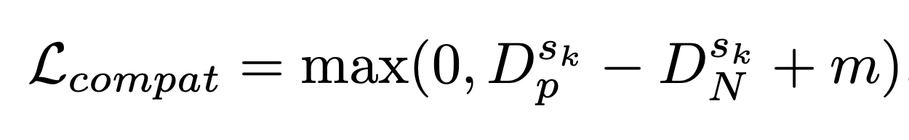
Losses

Slide 41
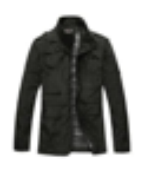


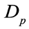
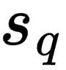
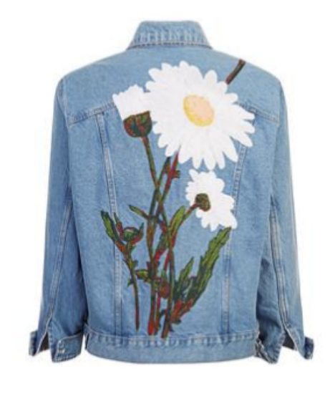
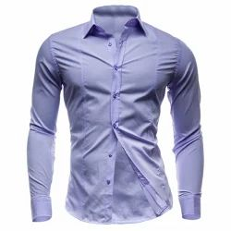
Losses

Slide 42
Losses

Slide 43
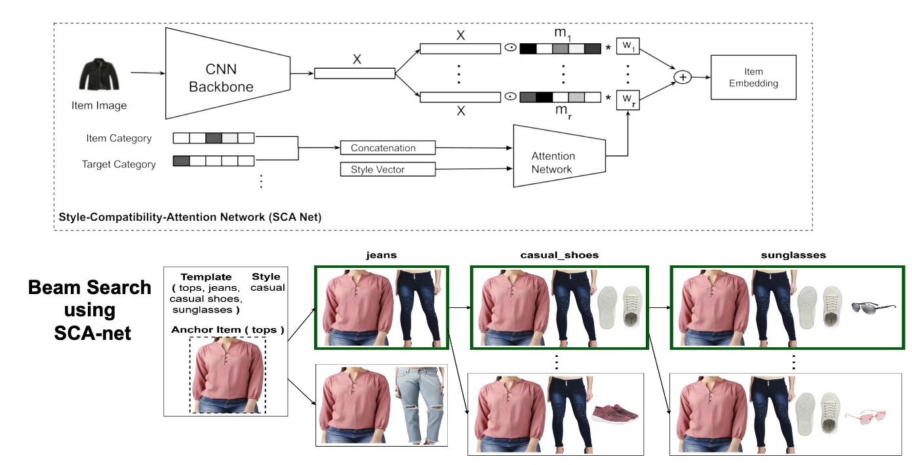
Outfit Generation

Slide 44
Outfit Generation
Random vector from
Training Data
Reference outfit!

Slide 45
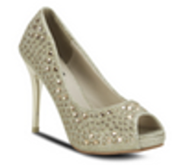
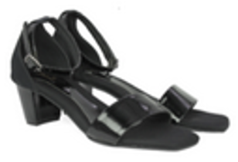
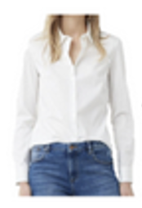





Quantitative Results
?
Fill In The Blank
Options

Slide 46





Quantitative Results

Slide 47

Quantitative Results - Style
Compatibility Score
Score 1
Style 1

Slide 48
Quantitative Results - Style
Score 1
Compatibility Score
Score 2
Style 2

Slide 49
Quantitative Results - Style
Score 1
Score 2
Compatibility Score
.
.
.
Score 8
Style 8

Slide 50
Quantitative Results - Style
Score 1
Score 2
Compatibility Score
.
Score k .
Score 8
Style k (Correct)

Slide 51

Quantitative Results - Style
Score 1
Score 2
Compatibility Score
.
Score k .
Score 8
Style k (Correct)

Slide 52


Qualitative Results - Style

Slide 53


Exploiting style conditioning

Slide 54

Exploiting the latent space

Slide 55


Exploiting the latent space

Slide 56

Recommendation of Compatible Outfits Conditioned on Style
Harsh Maheshwari*, Lucky Dhakad*, Debopriyo Banerjee* Muthusamy Chelliah, Niloy Ganguly, Arnab Bhattacharya
Flipkart
Flipkart
IIT Kgp
Flipkart
IIT Kgp
Flipkart

Slide 57

Preview of current research at Georgia Tech
Segmentation Prediction
Using Knowledge distillation techniques
On transformer-based segmentation models

Slide 58

Preview of current research at Georgia Tech
Segmentation Prediction
Missing modality!
Using Knowledge distillation techniques
On transformer-based segmentation models

Slide 59

Preview of current research at Georgia Tech
Submitting our work to ICCV 2023

